Slide 1

Installing - Java -

Slide 2
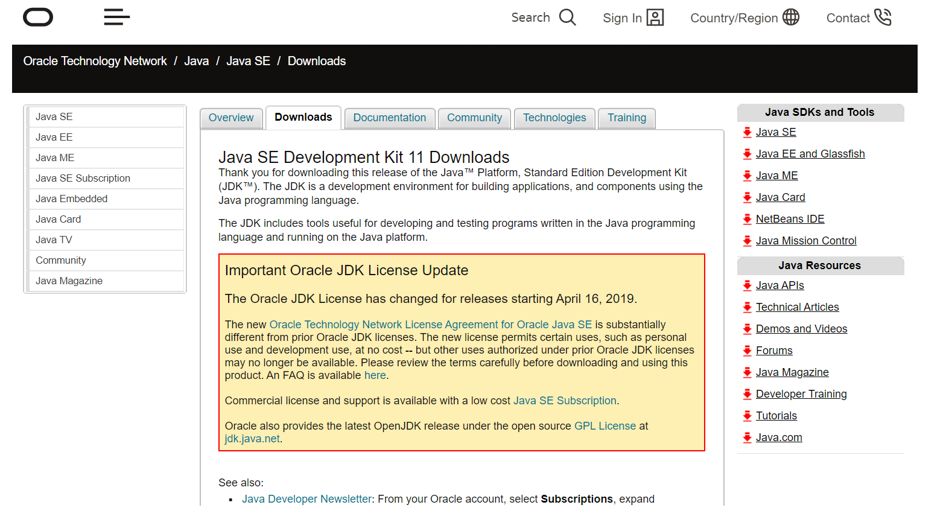
Downloading Java
Download Java SE Development Kit 11 from this link.

Slide 3
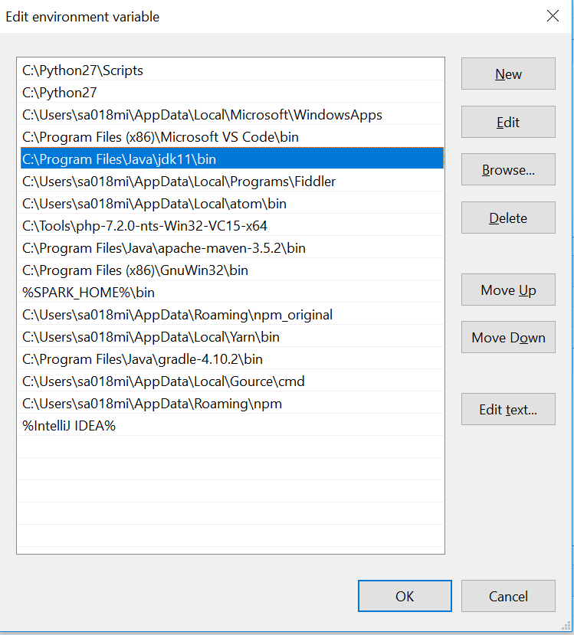
Installing Java
Click and run the downloaded installer. While installing the installer shall asks for an installation path.
After successful installation , copy the path to
<JDK Installation path>/bin.
Add above copied path to windows environment variables.
This makes java executables available from everywhere within the current OS installation.

Slide 4
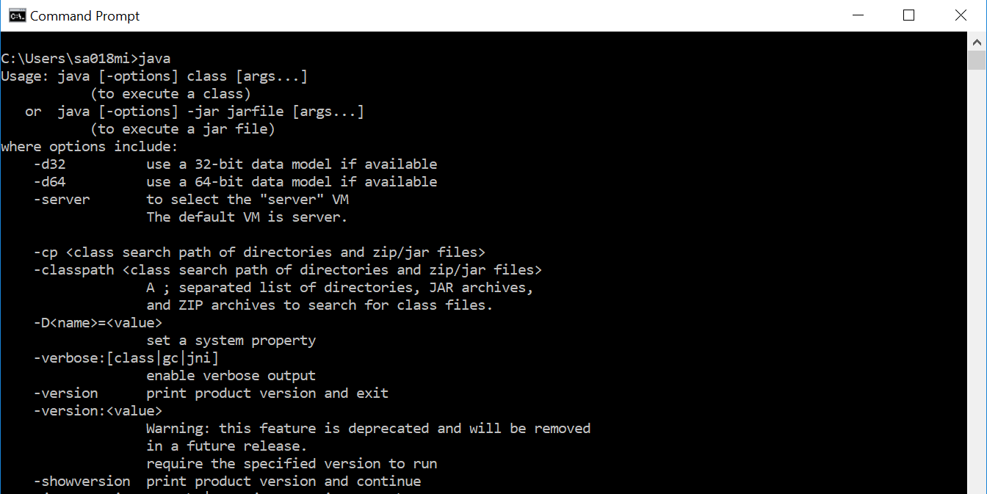
Is Java available on my system ??
Check to verify whether Java installation is installed and available from command line.

Slide 5
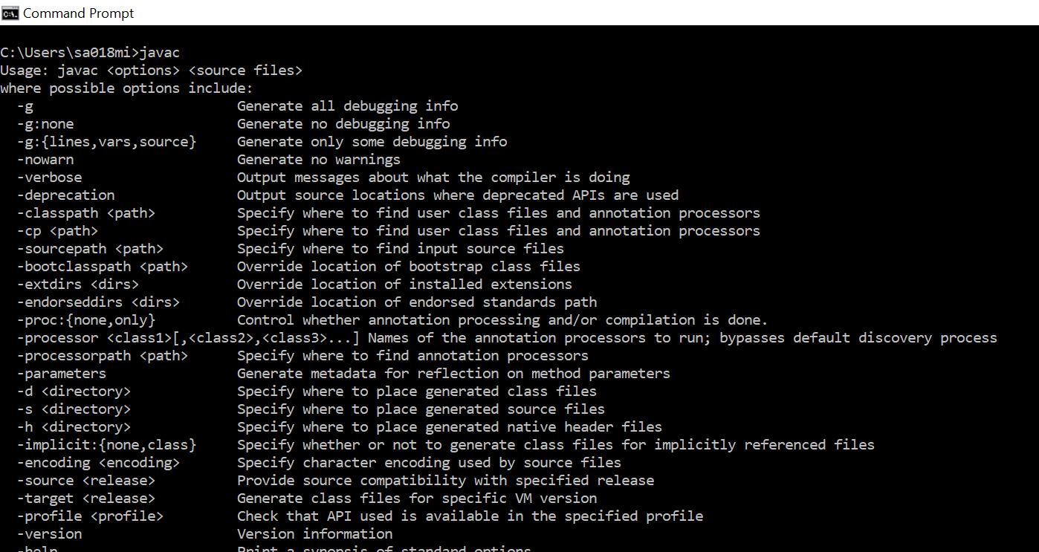
Is Java compiler available on my system ??
Check to verify whether Java compiler is available from command line.

